Slide 1
European History Vocabulary and Significant People Exploration - Age of Imperialism

Slide 2
European Vocabulary
Renaissance – French word for “rebirth” (Science, Art, and Ideas) that began in Italy in the mid 1300s.
Reformation – Movement that began in the 1500s by Martin Luther to change Western Christianity. This led to the emergence of Protestant Christianity.
Conquistadors – Spanish soldiers who conquered the new world.

Slide 3
Significant People – Renaissance and Reformation
Johannes Gutenberg – Invented the printing press
William Shakespeare – Wrote Romeo and Juliet, Hamlet, and Macbeth.
Leonardo Da Vinci – Painted the Mona Lisa and The Last Supper.
Martin Luther – Started the reformation in Europe and also translated the Latin Bible into German.

Slide 4
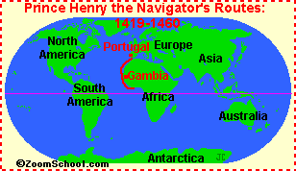
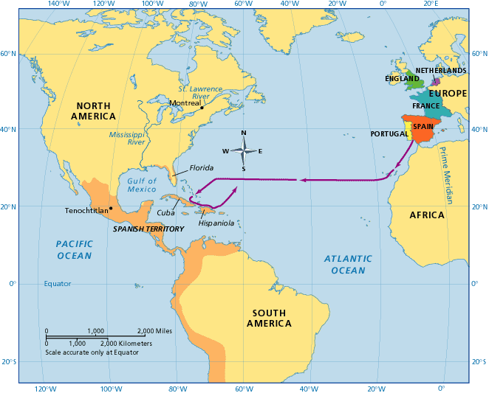
Significant People – Age of Exploration
Prince Henry the Navigator – Portuguese explorer who established a school for the study of the arts of navigation, mapmaking, and shipbuilding. He also sponsored voyages down the African coast.
Vasco Da Gama – First European explorer who sailed from Portugal to India.
Christopher Columbus – Credited for discovering the New World. He also created detailed maps of the Caribbean and Central America.

Slide 5
Significant People – Age of Exploration

Slide 6
Significant People – Age of Exploration
John Cabot – Explored and claimed part of Canada for the British.
Ferdinand Magellan – First explorer to completely sail around the world (although he died). He named the Pacific Ocean. Strait of Magellan (Southern tip of South America) is named after him.
Jacques Cartier – Sailed the St. Lawrence Seaway for France.

Slide 7
European Vocabulary
Crusades – Military expeditions to conquer the holy land from the Turks.
Missionaries – A person who is sent by their church to convert people to Christianity
N…. http://www.youtube.com/watch?v=butJ52nCLC0
Nationalism – Pride in one’s country

Slide 8
European Vocabulary
Colony – A region that is ruled by another country.
Imperialism – This is also known as colonialism. It is when countries compete for land and power.

Slide 9
So why did Europeans explore?
The Ottoman Empire blocked the Silk Road, a trade route from India that provided Europeans with spices, in 1453.
Europeans wanted more wealth – Natural Resources, like gold and spices, helped European economies become very wealthy.
Claim new lands – by claiming new lands, Europeans gained nationalism and honor.
Spread of Christianity

Slide 10
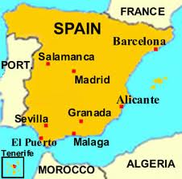
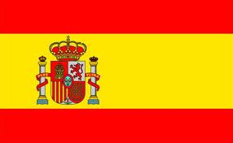
Spain

Slide 11
Explorers from Spain
Christopher Columbus
Ferdinand Magellan
Vasco de Balboa
Francisco Pizzaro
Hernan Cortez

Slide 12
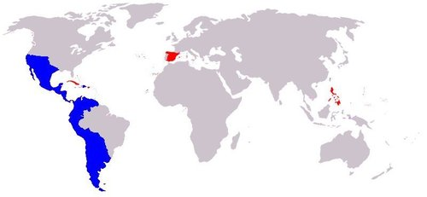
What present-day countries did Spain colonize?
All of Central and South America except Brazil and French Guinea
Philippines
Guam
Western Sahara
Equatorial Guinea

Slide 13
When did Spain control these Empires?
From the early- mid 1500s Spain started colonizing different areas of the New World. Spain colonized place all around the world. This lasted until 1914.

Slide 14
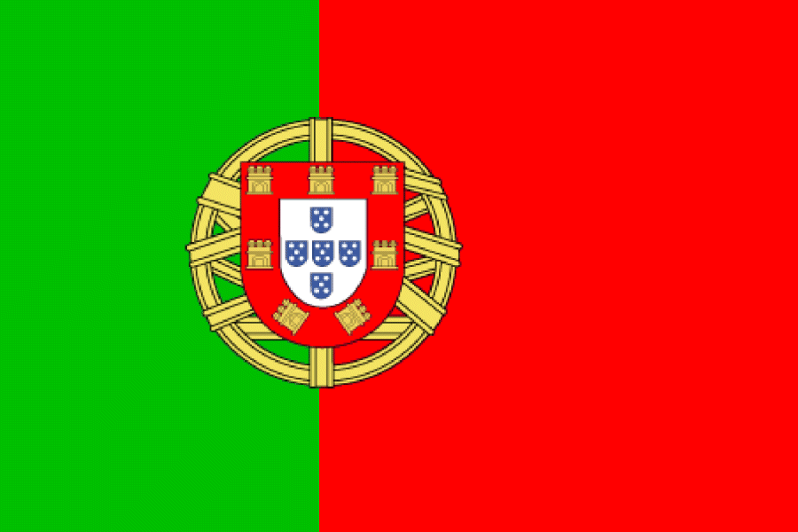
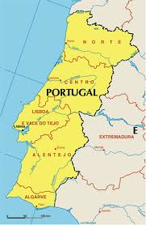
Portugal

Slide 15
Explorers from Portugal
Prince Henry the Navigator
Barolomeu Dias
Vasco De Gama

Slide 16
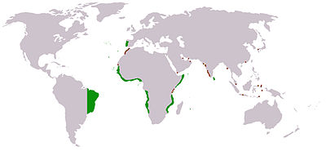
Portugal’s Colonies
Brazil
Angola
Guinea-Bissau
Mozambique
Japan

Slide 17
When did Portugal control these Empires?
From the early- mid 1500s Portugal started colonizing different areas of the New World. Until 1822, Brazil was a very profitable Portuguese colony.

Slide 18
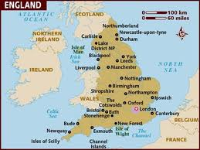
England

Slide 19
Explorers from England
John Cabot

Slide 20
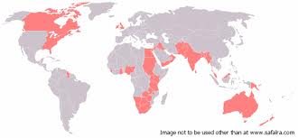
What present-day countries did England colonize?
Canada
United States
Australia
New Zealand
Malaysia
India
Pakistan
Egypt
Israel
Jordan
Nigeria
Uganda
Many others
Hong Kong was the last English colony to gain independence in 1997!

Slide 21
When did England control these Empires?
From the early- mid 1500s England started colonizing different areas of the New World. England was a strong force in the Age of Imperialism. This lasted until the late 1900s.

Slide 22
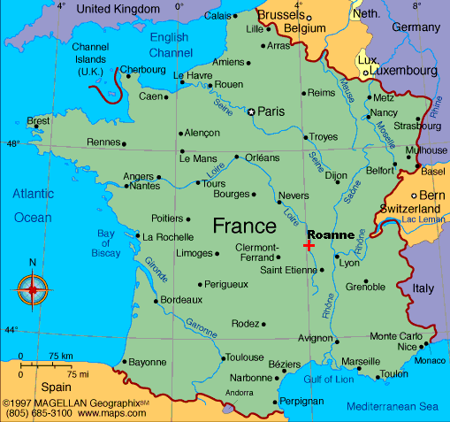
France

Slide 23
Explorers from France
Jacques Cartier

Slide 24
What present-day countries did France colonize?
French Guiana
Haiti
Western Africa
Tunisia
Cambodia
Vietnam

Slide 25
When did France control these Empires?
From the early- mid 1500s Portugal started colonizing different areas of the New World. France lost its last colony in 1962.

Slide 26
Here is a closer look at Africa’s Imperialism

