Slide 1
European Geography Vocabulary

Slide 2
5 Themes of Geography
1. Location – This deals with relative and absolute location (latitude and longitude).
2. Place - Place describes the human and physical characteristics of a location. Physical characteristics include a description such things as the mountains, rivers, beaches, topography, and animal and plant life of a place.
3. Human Environmental Interaction – This theme deals with how humans interact and modify the environment.

Slide 3
5 Themes of Geography
4. Movement – Humans move, a lot! In addition, ideas, fads, goods, resources, and communication all travel distances. This theme studies movement and migration across the planet.
5. Region - Region divides the world into manageable units for geographic study. Examples include cities, states, countries, “the South,” or “the Midwest.”

Slide 4
Vocabulary Terms
Continent – A massive land area
Country - A nation with its own government, occupying a particular territory; an area of land of a nation
Island – A body of land smaller than a continent and completely surrounded by water

Slide 5
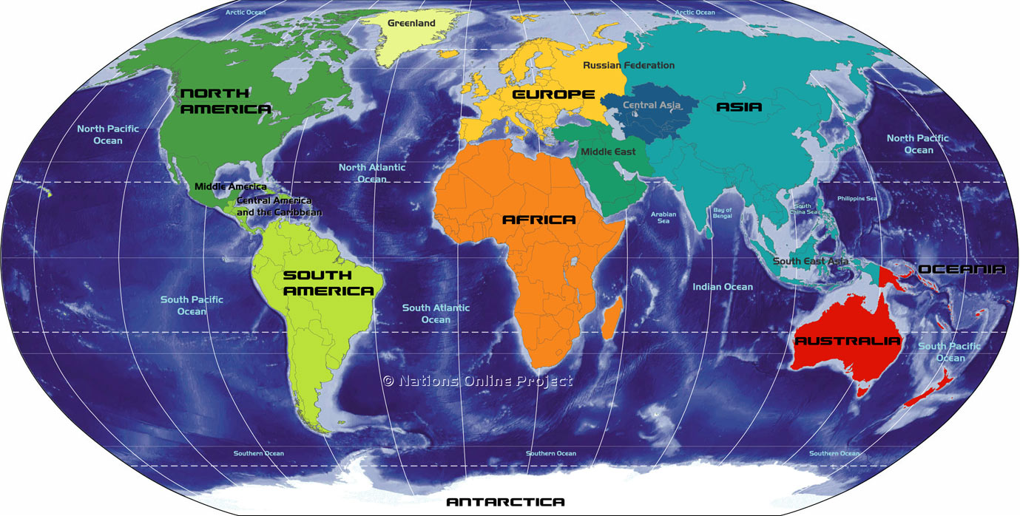
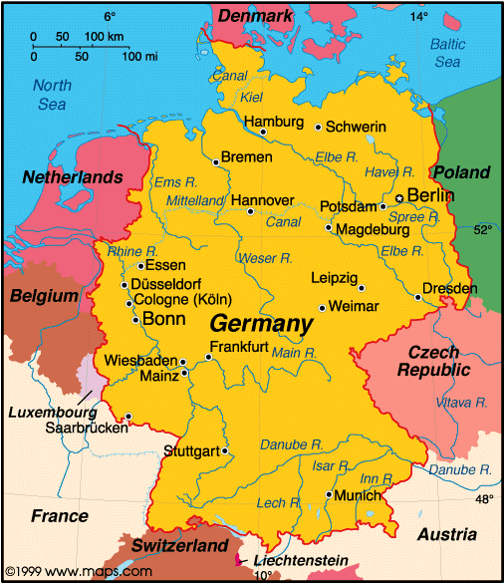
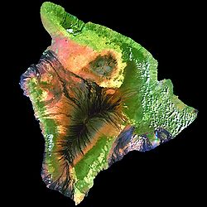
Vocabulary Terms

Slide 6
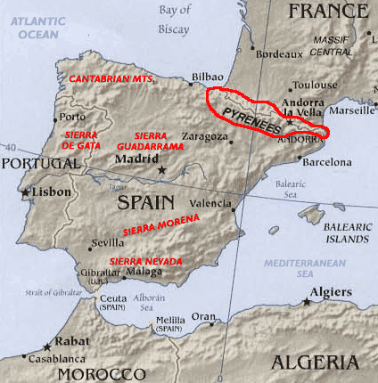
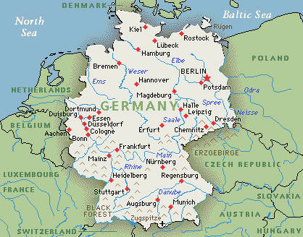
Vocabulary Terms
Border – An imaginary line that divides two countries
Boundary – A natural border that divides two countries

Slide 7
Vocabulary Terms
Peninsula – A land area that is surrounded by water on three sides
Plain – Low-lying stretch of flat or gently rolling land
Channel – A body of water joining two larger ones.

Slide 8
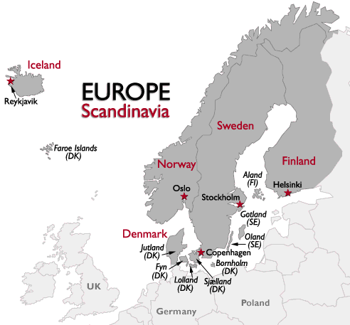
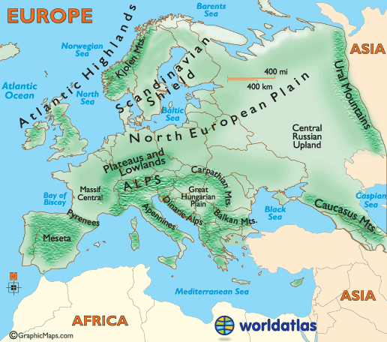
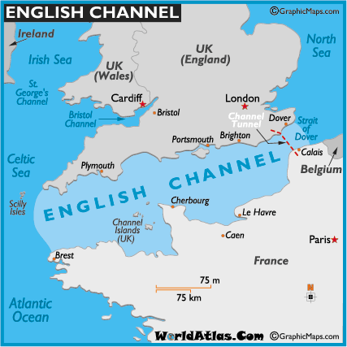
Vocabulary Terms

Slide 9
Review
What are the 5 themes of Geography?
What is the difference between an island and a peninsula?
What is a channel?

